Slide 1
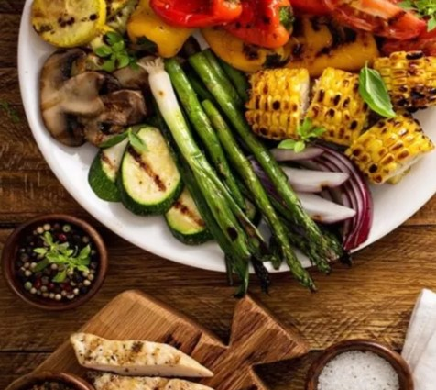
Resto-FOOD ORDERING WEBSITE
Prepared by:-
22AIML041 - Sudarshan Ponkia
22aiml053 – Malak Soni
22aiml056 – Ansh Trivedi

Slide 2

Problem Description
Today, restaurant waiter takes the customer ordering by manual system with using paper. Restaurant management system puts the order in a queue with specific priority according to time and quantity. Initial problem is that the customer has to get connected over the phone; it would be harder if the restaurant is very popular and busy. Sometimes, waiter information and customer information is important to restaurant administrator for reference in the future. The chances of committing mistakes at the restaurant side in providing a menu list for a specific time would be more.

Slide 3
Existing Approach
Our Website provides a convenient interface which helps owners to manage their food orders.
The main point of developing this system is to help restaurant administrator manage the restaurant business.
It may become very easy to choose the perfect food from the menu by reviews given by another customers.

Slide 4
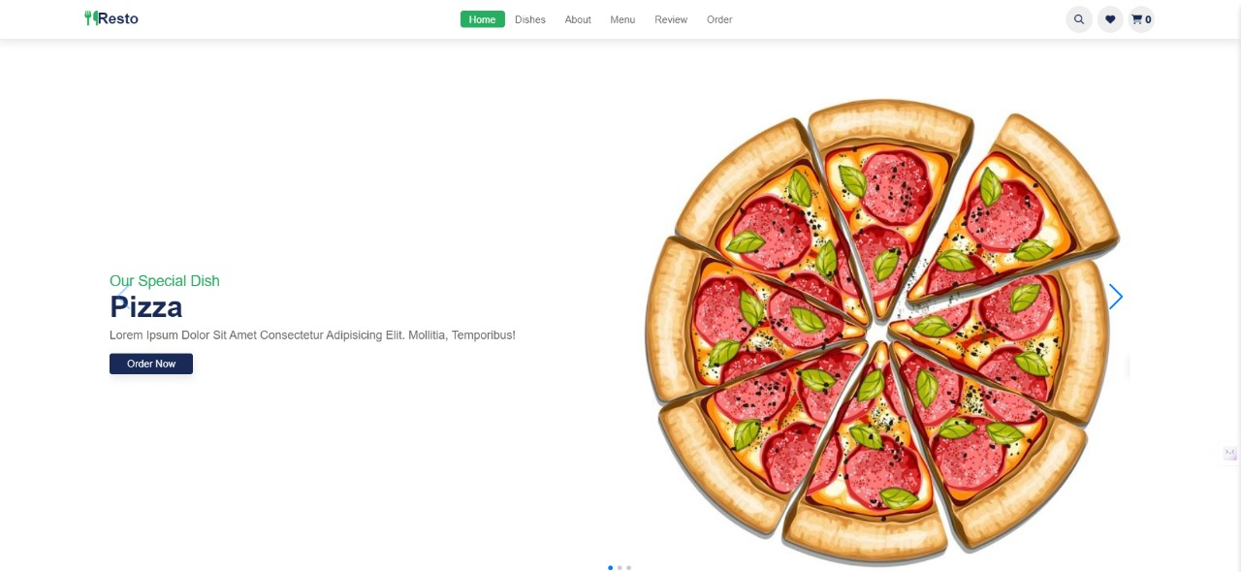
OVERALL STRUCTURE

Slide 5




Sections
1.
Home Section contains the information about the Special Dish Of the restaurant
2.
It contains few popular dishes of restaurant that are rapidly ordered.
3.
It gives some brief description about the Restaurant.
4.
It has all food items with the picture and the ratings of other customers

Slide 6
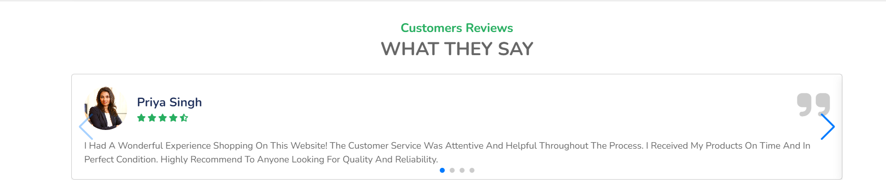
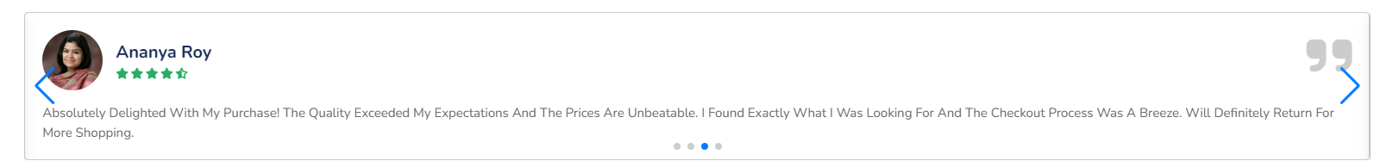
Sections
5. Review:
It has reviews about the food and restaurant given by the other customers and also can write review and experience had at the restaurant.
6. Order:
From this section customer can directly order the food by filling some personal details such as name & phone number etc.

Slide 7

Buttons
1. Search Button: From here customer can search for any dishes
2. Admin: It enables the admin to view all the order details by the customers and manage and delete the orders by signing in with admin credentials.
3. Cart Button: It shows the items which customer has added to cart and directly order from here.

Slide 8
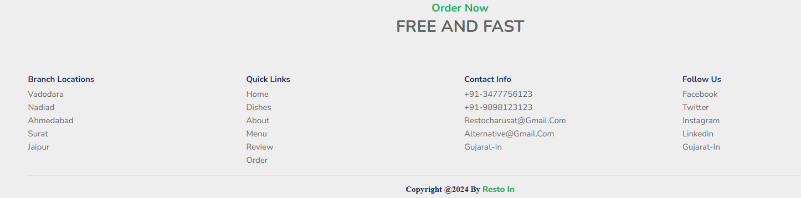
Footer Section
1. Location Section: It lists the location where restaurants are present.
2. Quick Links: It has tabs of the header section.
3. Contact Info: It shows the contact related information such as email address and contact number.
4.Follow Us: It has some social media links where the customers can follow us and stay tuned to the latest updates .

Slide 9
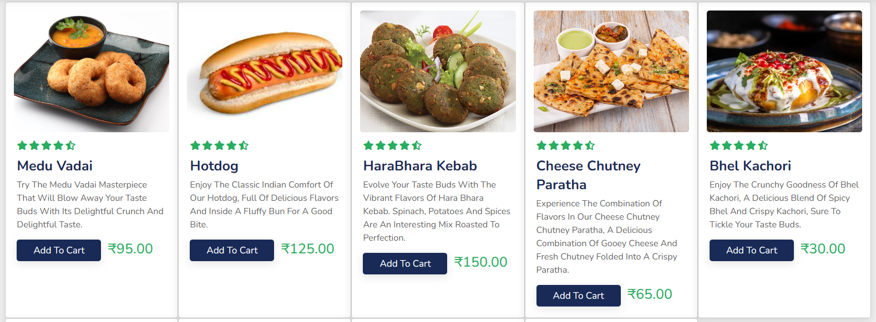
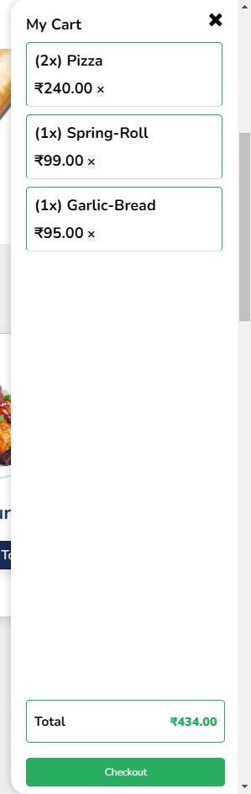
Add to cart and checkout

Slide 10
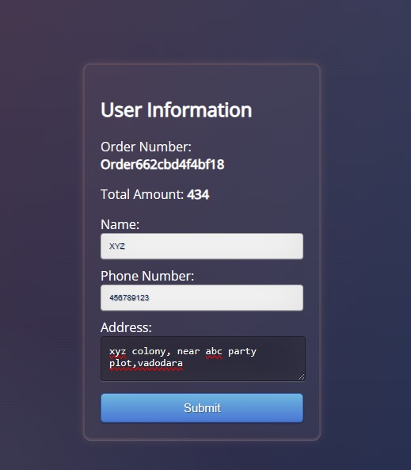
User Information
As soon as the user checkouts He / She has to fill the following
information.
1. Name
2. Phone Number
3. Address
As soon as information is filled his/her order will get confirmed.

Slide 11
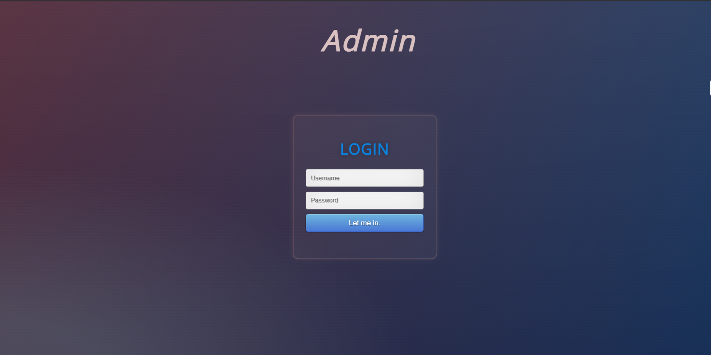
Admin Login Page

Slide 12
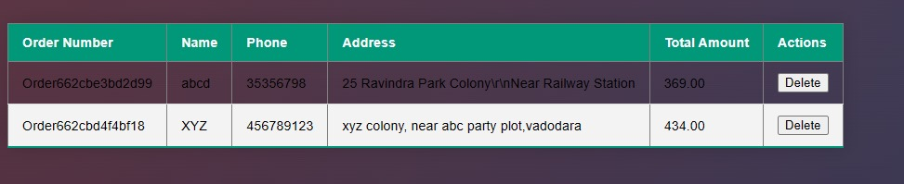
Customer Orders
Admin can login to his website using his username and password.
Here there are 3 admins.
They can manage the food order and remove the completed order .

Slide 13
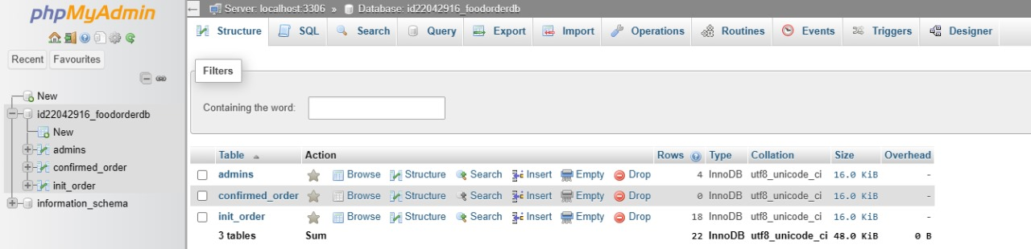
Data Base Design
Tables
1. Admins
2. Confirmed order
3.Initial order

Slide 14
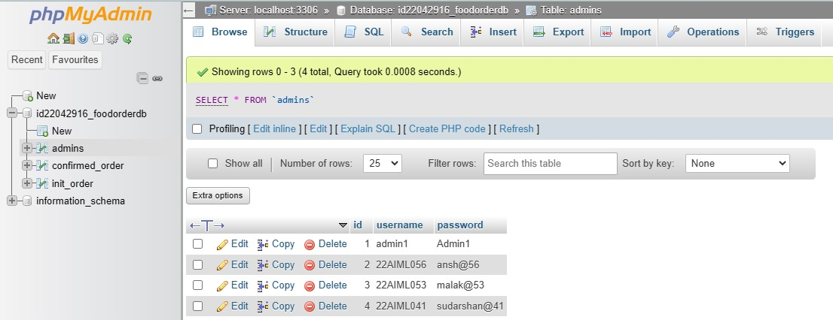
Admins Table

Slide 15
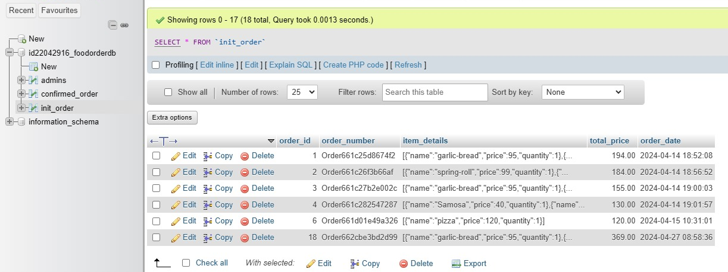
Initial Orders Table

Slide 16
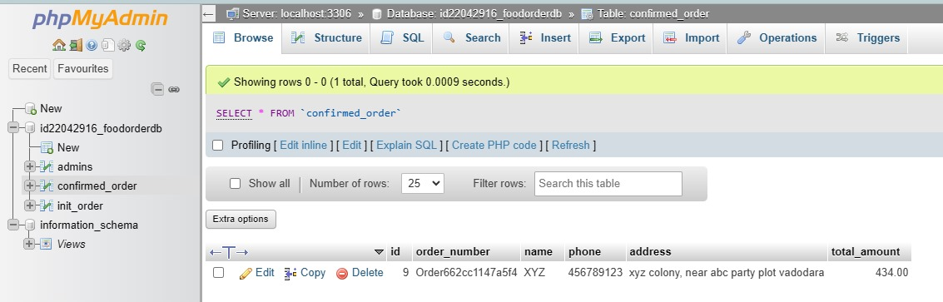
Confirmed Orders Table

Slide 17
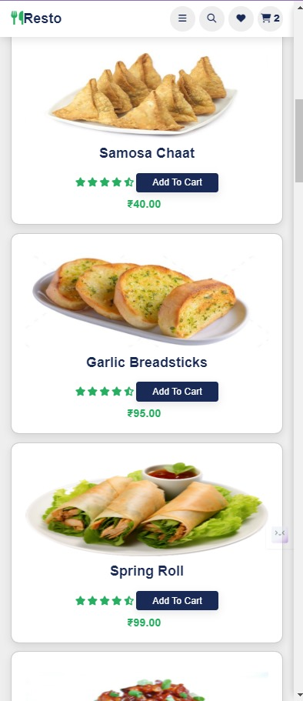
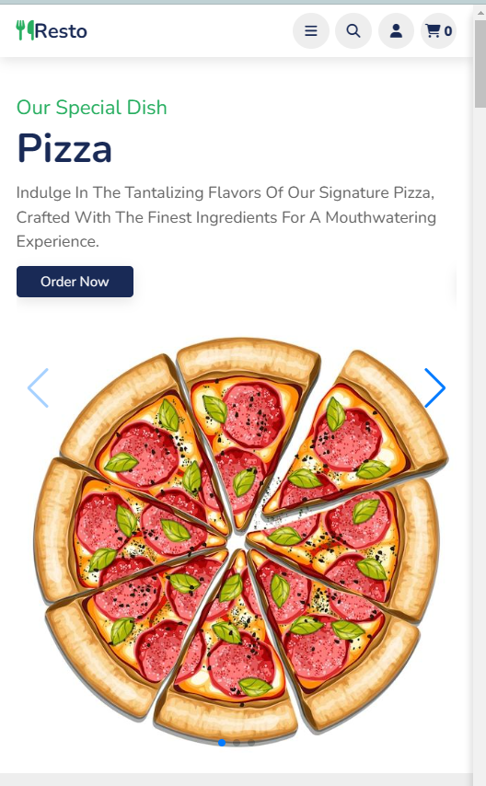

RESPONSIVENESS

Slide 18





Technologies Used

Slide 19
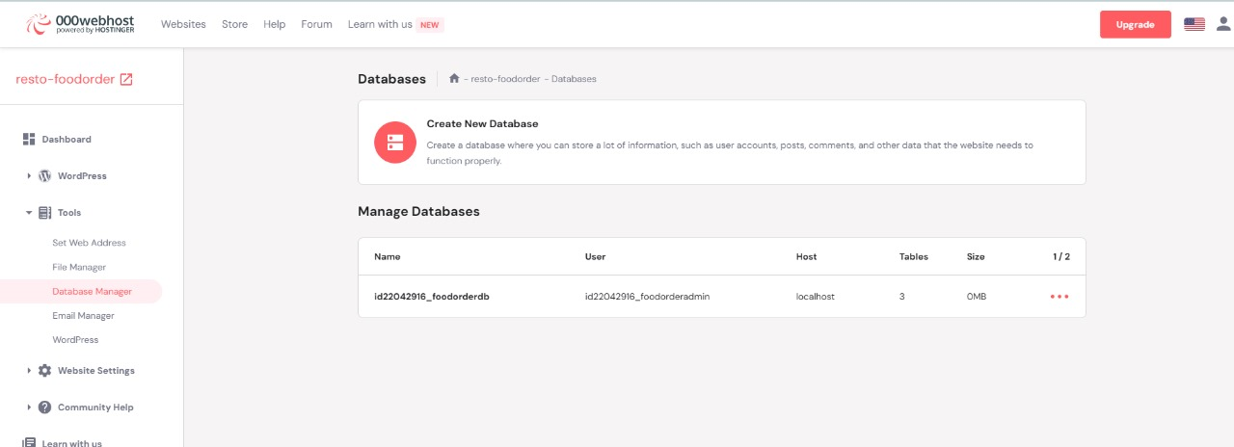
Hosting Platform

Slide 20


